Slide 1

CASE HEARING SYSTEM
Date:26-11-2022

Slide 2

Name: Rishabh Maloo Enrollment No. :21162101023 Department : CBA PID : 672 Email:rishabhsmallo21@gnu.ac.in

Slide 3
PROBLEM
MORE THAN 4.7 CRORES OF CASES ARE PENDING IN INDIA.
THE MAJOR REASON IS DELAYING OF HEARING DATES.

Slide 4

MARKET ANALYSIS
ANNUAL EXPENDITURE ON JUDICIAL SYSTEM IS 1,56,000 CRORE RUPEES.
THERE ARE 25 HIGH COURTS IN INDIA WHERE IT IS REQUIRED TO HAVE PROPER CASE HEARING SYSTEM.

Slide 5
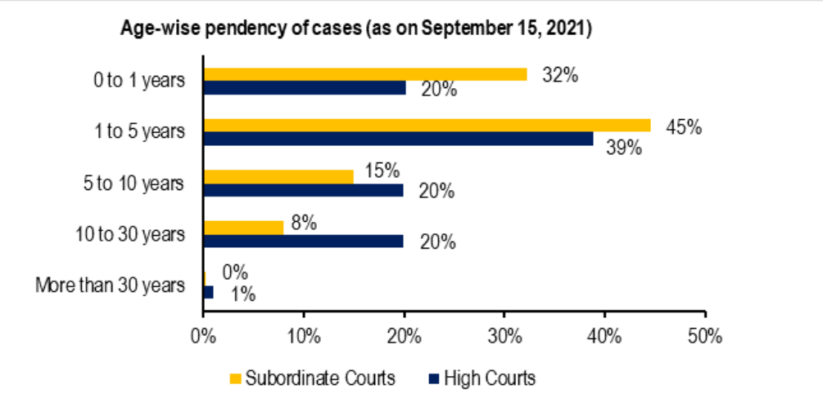

Slide 6
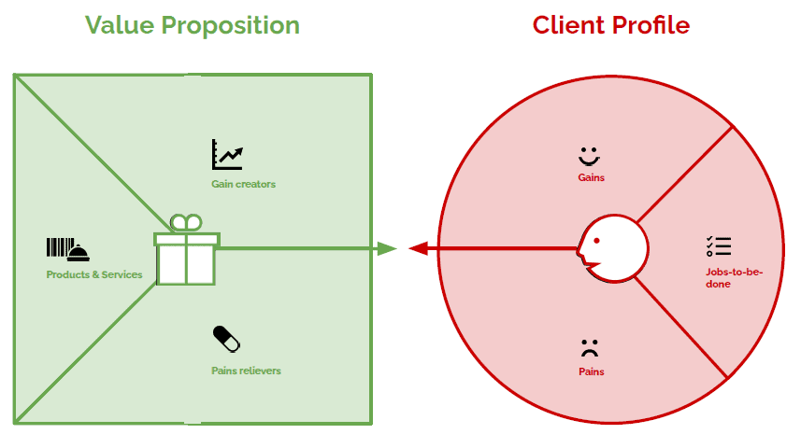
The no. of hearing increase day-by-day.
Verdict comes on the latest hearing.
Device having information related to real-time scenarios.
Teaching of working of software
FIT
People having hearing same day and not getting other date.
Getting new dates by failing to reach on time

Slide 7
EMPATHY MAP

Slide 8
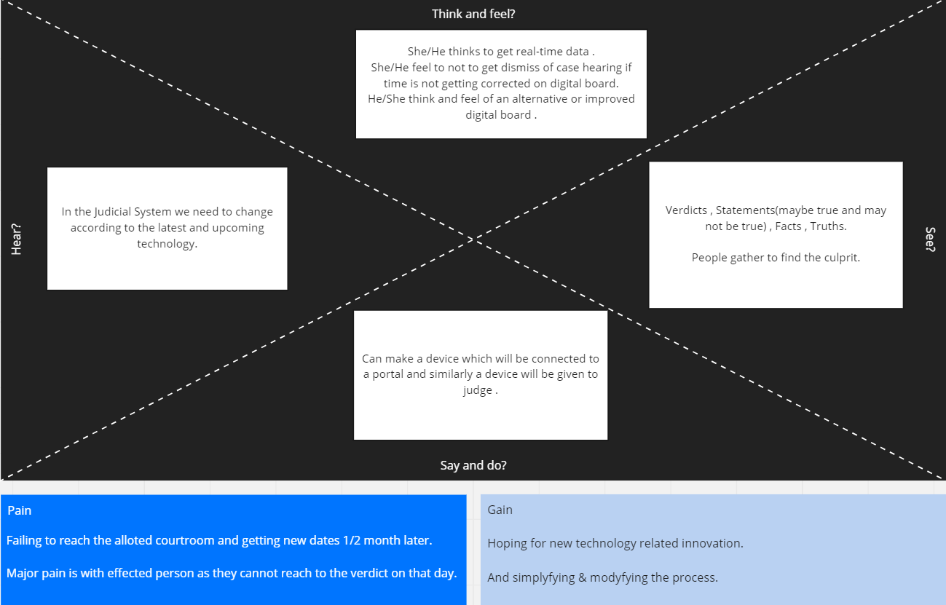

Slide 9
BUSINESS MODEL CANVAS

Slide 10
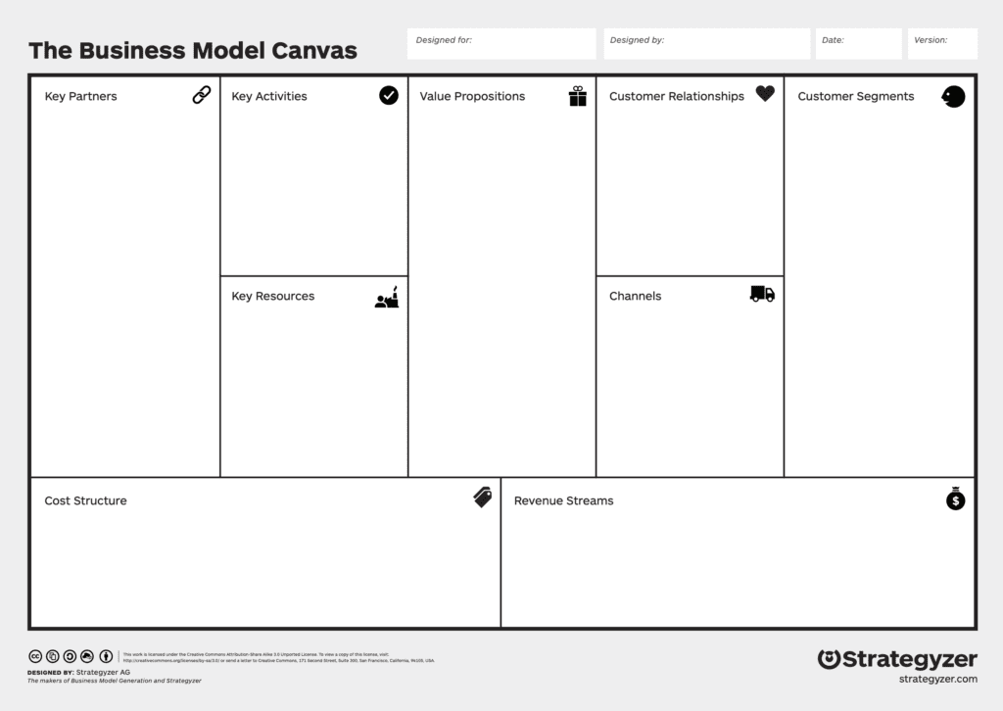
Case Hearing System
Rishabh Maloo
- Working of device
-Portal management
Online Contact/
Interaction.
Courts,
Individulal
Working
in/out for
court
- The no. of hearing increase day-by-day.
Time Saving
Verdict comes on the latest hearing
Courts
Schedule of courts
Device
-Goverment
Government.
Court
Hiring Developers/Technician.
Portal making.
Technology used in building portal & device.

Slide 11
SCAMPER TOOL

Slide 12
SCAMPER
S – SUBSTITUTE – We can substitute the device with the digital board.
C – COMBINE – Technology can be combined with real-time data.
A – ADAPT – Lawyers and Judges can adapt the new technology by learning from the innovaters .
M – MODIFY/MAGNIFY – It is already small but can be magnified with some additional data.
P – PURPOSE – Time management of cases and timely conduction of any case.
E – ELIMINATE – We can eliminate the unwanted files and can store them in cloud .
R – REVERSE/REARANGE – The data will be saved as it was previously but the way of representation will be rearranged.

Slide 13

FUNDING REQUIREMENT FOR PERIOD OF 3 YEARS.

Slide 14
FUNDING REQUIRED → ₹1CR LAKHS FOR THE FIRST THREE YEARS.
YEAR 1 EXPENSES →
1)Hiring new Engineers for developing the prototype.
2) Renting , Salaries to employees , Testing .
3)Creating a small prototype and working of it in small level court.
YEAR 2 EXPENSES →
1)As we will be serving the court as in whole then NO Marketing is required.
2)The database and server through which data exchange happens.
3)Small or feasible changes which will be done on reviews.
4)Hiring of management .
YEAR 3 EXPENSES →
1)Big scaling on device for various courts.
2)Requirement of talent for large scaling.

Slide 15
THANK YOU!!!

